Slide 1

DRAFT 0.2 - NOT PUBLISHED
Generic Air Force structure
INTREP B-001
NOTE: This document and structure is a simplification and a compromise between real world organization and DCS limitation, while respecting that this is a hobby and not anyones job.
Notes:
Verson 0.1: Draft 1

Slide 2
Introduction
This report is part of the basic intelligence for 132nd hosted events.
The aim of this report is help pilots understand the organization and structure of enemy air forces.
The structure in this document is generic and the actual structure in a operation is given as intelligence for that operation.

Slide 3
Version control
Version number | Date | Information changed
0.1 (DRAFT) | 2020-04-26 | Initial version
0.2 | 2020-04-27 | Added Squadron description Added SEAD/EW regiment
Back to content
Back to Air Force

Slide 4
Content
Aircraft Roles
Squadron Description
Squadron composition
Readiness
Hierarchy
Air Force Organization
Back to content
Back to Air Force
4

Slide 5
Aircraft roles
Aircraft | Primary role | Secondary role | Name | Year
MiG-21 | Interceptor |  | FISHBED | 1959
MiG-23 | Fighter |  | FLOGGER | 1970
MiG-25 PD | Interceptor |  | FOXBAT A | 1970
MiG-25 RBT | Reconnaissance | Bomber | FOXBAT B | 1970
MiG-27K | Ground attack |  | FLOGGER D/J | 1975
MiG-29A | Fighter | Ground attack | FULCRUM | 1982
MiG-29S | Fighter | Ground attack | FULCRUM-S | 1982
MiG-31 | Interceptor |  | FOXHOUND | 1981 | Replace Mig-25
SU-17 M4 | Fighter bomber |  | FITTER-K | 1980
SU-24 M | Attack (A-G) |  | FENCER-D | 1979
SU-24 MR | Reconnaissance |  | FENCER-E | 1980
SU-25 | CAS | SEAD | FROGFOOT | 1981
SU-25 T | Anti-tank |  | FROGFOOT | 1991
SU-25 TM | Attack |  | FROGFOOT | 2008
SU-27 | Fighter | Fighter escort | FLANKER | 1985
SU-30 | Fighter/attack | Deep interdiction | FLANKER-C | 1996 | Similar to F15E
SU-33 | Fighter |  | FLANKER-D | 1998 | Carrier
SU-34 | Fighter-bomber | Strike, EW/SEAD | FULLBACK | 2006
TU-142 | ASW | Anti-ship(ASUW) | BEAR | 1972
TU-160 | Strategic bomber |  | BLACKJACK | 1987
TU-22 M3 | Strategic bomber | Anti-ship(ASUW) | BACKFIRE-C | 1972
TU-95 MS | Cruise Missiles |  | BEAR-H | 1981
A-50 | AWACS |  | MAINSTAY | 1984
AN-26 B | Transport |  | CURL | 1970
AN-30 M | Reconnaissance |  | CLANK | 1968
IL-78 M | AAR |  | MIDAS | 1987
IL-76 MD | Transport |  | CANDID | 1974
YAK-40 | VIP transport | EW | CODLING | 1968
Back to content
Back to Air Force

Slide 6
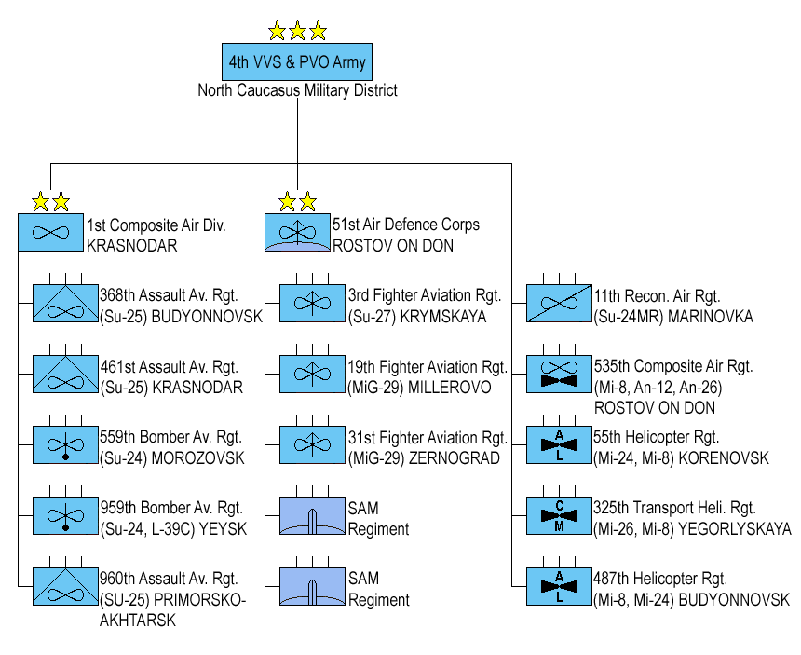
Squadron Description
Bomber
A bomber squadron conduct Air Interdiction missions. The aircraft in a bomber squadron have a limited A-A capability for self-protection. A squadron consist of 12 aircrafts.
Fighter
The fighter squadrons conduct normal fighter operations such as DCA (CAP) and OCA (Sweep, Escort). A squadron consist of 12 aircraft.
Air Force
Heavy bomber
Heavy bomber squadron conducts long-range strategic attacks, and heavy bombing duties. A squadron consist of 6 Aircraft.
Air Division
Assault
Assault squadrons conduct Close Air Support and Armed Recon missions. A squadron consist of 12 aircraft.
Reconnaissance
A reconnaissance squadron is used to gather intelligence about the enemy either visually or electronically. A squadron consist of 6 aircraft.
Air Regiment
Interceptor
Squadron that is specialized in DCA with the purpose of intercepting incoming enemy aircraft. Squadron consist of 12 aircraft.
Air Squadron
Tanker
Squadron conducts AAR for other aircrafts.
Squadron consist of 6 Aircraft.
Transport
A transport squadron is used for transporting supplies, personell or material. This can either be a logistic operation or a airborne operation. Squadron consist of 6 aircraft.
Airborne Early Warning
Squadron conducts Airborne Early Warning, and can be tied into the regions IADS. A Squadron consist of 4 Aircraft.
Anti-ship
A Anti-ship squadron conducts maritime patrolling, or conducts Anti Surface Warfare (ASUW) where it attacks ships at sea. Carrier groups is their primary target. A squadron consist of 6 aircraft.
Bomber Aviation Regiment
Assault Aviation Regiment
Fighter Aviation Regiment
SEAD/EW
SEAD/EW squadrons are designed to attack Air Defence of the enemy and will normally support other operations. A squadron consist of 6 aircraft.
SU-24
SU-25
SU-27
MiG-29
Back to content
Back to Air Force

Slide 7
Squadron Composition
Bomber
SU-24 / SU-30 / SU-34
Fighter
MiG-23/MiG-29 / SU-27 / SU-30 /SU-33
Air Force
Heavy bomber
TU-160/ TU-22 /TU-95
Air Division
Assault
MiG-27/ MiG-29/SU-17/ SU-25 / SU-34
Reconnaissance
SU-24 MR/ MiG-25 RBT/ AN-30
Air Regiment
Interceptor
MiG-21 / MiG-25 / MiG-31
Air Squadron
Tanker
IL-78
Transport
AN-26B/IL-76/YAK-40
Airborne Early Warning
A-50
Anti-ship
TU-22 /TU-142
Bomber Aviation Regiment
Assault Aviation Regiment
Fighter Aviation Regiment
SEAD/EW
YAK-40, SU-25, SU-24, SU-34, SU-30
SU-24
SU-25
SU-27
MiG-29
Back to content
Back to Air Force

Slide 8
Readiness
High readiness:
A squadron with high readiness is combat ready in support of an offensive, or pre-planned need for high readiness. The squadron have conducted preventive maintenance to support combat operations.
A squadron with high readiness have 75% of the aircraft in the squadron ready for missions, with the remaining aircraft undergoing maintenance.
Example:
12 AC: 9 aircraft ready (8-10)
6 AC: 4-5 aircraft ready (3-5)
4 AC: 3 aircraft ready (2-4)
Normal readiness:
A squadron with normal readiness is combat ready, and are in combat, flying combat operations while doing maintenance of the aircrafts
A squadron with normal readiness have 50% of the aircraft in the squadron ready for missions, with the remaining aircraft undergoing maintenance.
This is the default state of the squadrons.
Example:
12 AC: 6 aircraft ready (5-8)
6 AC: 3 aircraft ready (2-4)
4 AC: 2 aircraft ready (1-3)
Low readiness:
A squadron with low readiness is limited combat ready, after a period of combat operations (or other reasons), the squadron need to do maintainance and prepare the aircrafts and pilots for operations. In this phase the squadron only will have a limited amount of aircraft (with crew) available for combat, flying combat operations while doing maintenance of the aircrafts.
A squadron with low readiness have 25% of the aircraft in the squadron ready for missions, with the remaining aircraft undergoing maintenance.
Example:
12 AC: 3 aircraft ready (2-6)
6 AC: 1-2 aircraft ready (0-3)
4 AC: 1 aircraft ready (0-2)
Back to content
Back to Air Force

Slide 9
Hierarchy
Air Force
Highest echelon in a sector or country. Led by a 3-star general. Will normally have 3 Divisions.
Air Division
A Air Division may have several regiments of various types. Led by a 2-star general.
Air Regiment
A regiment have the same mission set. Each regiment have 2-4 squadrons with different types of aircraft. Led by a 1-star general
Air Squadron
Smallest organization in the Air Forces. Consist of same type of aircraft. Equipped with 6-12 aircraft depending on what kind of squadron
The enemy force may have several numbered Air Force’s in its structure (it will vary based on the campaign/event). However the numbered Air Forces will have a similar structure
Example: Russia may have the 2nd Air Force and 4th Air Force in 2 different sectors.
Back to content
Back to Air Force

Slide 10
Air Force Organization
Air Force
Air Force
Bomber Division
Air Defense Division
Composite Air Division
Bomber
Air Division
Bomber Aviation Regiment
Fighter Aviation Regiment
Tanker Aviation Regiment
Fighter
Bomber Aviation Regiment
Fighter Aviation Regiment
Transport Aviation Regiment
Air Regiment
Assault Aviation Regiment
Fighter Aviation Regiment
Reconnisance Regiment
Heavy bomber
Air Squadron
Assault Aviation Regiment
Interceptor Aviation Regiment
AEW Squadron
Assault
Heavy Bomber Aviation Regiment
Anti-ship Regiment
Reconissance
EW/SEAD Regiment
Interceptor
Tanker
Transport
NOTE: The size of the various regiments will vary, each regiment will consist of 2-4 squadrons. This will be listed in the
AEW: Airborne Early Warining
EW: Electronic Warfare
SEAD: Suppression of Enemy Air Defense
Airborne Early Warning
Back to content
Back to Air Force

Slide 11
Bomber Aviation Regiment
Bomber Aviation Regiment
Air Force
Bomber
Squadron
Bomber
Squadron
Air Division
Fighter
Air Regiment
Heavy bomber
Air Squadron
Assault
Reconissance
Interceptor
Tanker
Transport
Airborne Early Warning
Back to content
Back to Air Force

Slide 12
Heavy Bomber Aviation Regiment
Heavy Bomber Aviation Regiment
Air Force
Bomber
Air Division
Fighter
Air Regiment
Heavy bomber
Air Squadron
Assault
Reconissance
Interceptor
Tanker
Transport
Airborne Early Warning
Back to content
Back to Air Force

Slide 13
Assault Aviation Regiment
Assault Aviation Regiment
Air Force
Bomber
Air Division
Fighter
Air Regiment
Heavy bomber
Air Squadron
Assault
Reconissance
Interceptor
Tanker
Transport
Airborne Early Warning
Back to content
Back to Air Force

Slide 14
Fighter Aviation Regiment
Fighter Aviation Regiment
Air Force
Bomber
Air Division
Fighter
Air Regiment
Heavy bomber
Air Squadron
Assault
Reconissance
Interceptor
Tanker
Transport
Airborne Early Warning
Back to content
Back to Air Force

Slide 15
Interceptor Aviation Regiment
Interceptor Aviation Regiment
Air Force
Bomber
Air Division
Fighter
Air Regiment
Heavy bomber
Air Squadron
Assault
Reconissance
Interceptor
Tanker
Transport
Airborne Early Warning
Back to content
Back to Air Force

Slide 16
Reconissance Aviation Regiment
Reconissance Aviation Regiment
Air Force
Bomber
Air Division
Fighter
Air Regiment
Heavy bomber
Air Squadron
Assault
Reconissance
Interceptor
Tanker
Transport
Airborne Early Warning
Back to content
Back to Air Force

Slide 17
Anti-ship Aviation Regiment
Anti-ship Aviation Regiment
Air Force
Bomber
Air Division
Fighter
Air Regiment
Heavy bomber
Air Squadron
Assault
Reconissance
Interceptor
Tanker
Transport
Airborne Early Warning
Back to content
Back to Air Force

Slide 18
Tanker Aviation Regiment
Tanker Aviation Regiment
Air Force
Bomber
Air Division
Fighter
Air Regiment
Heavy bomber
Air Squadron
Assault
Reconissance
Interceptor
Tanker
Transport
Airborne Early Warning
Back to content
Back to Air Force

Slide 19
Transport Aviation Regiment
TransportAviation Regiment
Air Force
Bomber
Air Division
Fighter
Air Regiment
Heavy bomber
Air Squadron
Assault
Reconissance
Interceptor
Tanker
Transport
Airborne Early Warning
Back to content
Back to Air Force

Slide 20
AEW Regiment
AEW Regiment
Air Force
Bomber
Air Division
Fighter
Air Regiment
Heavy bomber
Air Squadron
Assault
Reconissance
Interceptor
Tanker
Transport
Airborne Early Warning
Back to content
Back to Air Force

Slide 21
EW/SEAD
EW/SEAD Regiment
Air Force
Bomber
Air Division
Fighter
Air Regiment
Heavy bomber
Air Squadron
Assault
Reconissance
Interceptor
Tanker
Transport
Airborne Early Warning
Back to content
Back to Air Force

